Slide 1
RDBMS
Avinash Pathak

Slide 2
Objectives
To understand the Relational Model
To update on the different facets of the data view
To apply the views to applications

Slide 3
RDBMS
The relational model is the most important data model for commercial data processing applications which achieved its primary position because of its simplicity, which makes the job of the programmer easy, in contrast to earlier data models such as the network model or the hierarchical model.

Slide 4
RDBMS
This software signifies the second generation of DBMSs and is based on the relational data model proposed by Mr. E. F. Codd in the year 1970.
A substantial theory exists for relational databases.

Slide 5
RDBMS
The relational model is the theoretical basis of relational databases which is a technique or way of structuring data using relations, which are grid-like mathematical structures consisting of columns and rows.
Codd proposed the relational model for IBM, but the idea became extremely vital and prominent that his work would become the basis of relational databases.
You might be very familiar with the physical demonstration of a relation in a database - which is known as a table.

Slide 6
RDBMS
In the relational model, all data is logically structured within relations, i.e., tables, as mentioned above.
Each relation has a name and is formed from named attributes or columns of data. Each tuple or row holds one value per attribute.
The greatest strength of the relational model is this simple logical structure that it forms.
Behind this simple structure is a sophisticated theoretical foundation that is lacking in the first generation of DBMSs.

Slide 7
RDBMS Objectives
To allow a high degree of data independence; application programs must not be affected by alterations to the internal data representation, mostly by changes to file organizations or access paths.
To provide considerable grounds for dealing with data semantics, reliability, and redundancy problems.
In particular, Codd's theory for the relational model introduced the concept of normalized relations, where relations that have no repeating groups and the process is called normalization.
To allow the expansion of set-oriented data manipulation languages.

Slide 8
Database Schema
When you talk about the database, you must distinguish between the database schema, which is the logical blueprint of the database, and the database instance, which is a snapshot of the data in the database at a given instant in time.
The concept of a relation corresponds to the programming language notion of a variable, while the concept of a relation schema corresponds to the programming languages' notion of the type definition.

Slide 9
Database Schema
In other words, a database schema is a skeletal structure which represents the logical view of the complete database.
It describes how the data is organized and how the relations among them are associated and formulates all the constraints that are to be applied to the data.
In general, a relation schema consists of a directory of attributes and their corresponding domain.

Slide 10
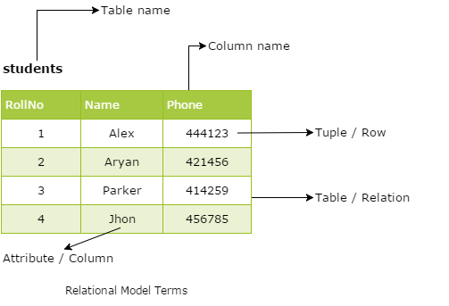

Slide 11
Database Schema
Relation:
A relation is a table with columns and rows.
Attribute:
An attribute is a named column of a relation.
Domain:
A domain is the set of allowable values for one or more attributes.
Tuple:
A tuple is a row of a relation.

Slide 12
Database Schema
A schema can be defined as the design of a database.
The overall description of the database is called the database schema.
It can be categorized into three parts.
These are as follows:
Physical Schema
Logical Schema
View Schema

Slide 13
Physical Schema
A physical schema can be defined as the design of a database at its physical level.
In this level, it is expressed how data is stored in blocks of storage.

Slide 14
Logical Schema
A logical schema can be defined as the design of the database at its logical level.
In this level, the programmers as well as the database administrator (DBA) work.
At this level, data can be described as certain types of data records which can be stored in the form of data structures.
However, the internal details (such as an implementation of data structure) will be remaining hidden at this level.

Slide 15
View Schema
View schema can be defined as the design of the database at view level which generally describes end-user interaction with database systems.

Slide 16
3 Level Architecture
A major objective for the three-level architecture is to provide data independence, which means that upper levels are unaffected by changes to lower levels.

Slide 17
Data Independence
Logical data independence can be defined as the immunity of the external schemas to changes in the conceptual schema.
Physical data independence can be defined as the immunity of the conceptual schema to changes in the internal schema.

Slide 18
Thank You

